Slide 1

Resist, comply or workaround? An examination of different facets of user engagement with information systems
Ferneley, E & SOBREPEREZ, P , 2006
UnIversıty of salford manchester
Presented BY Dilruba başak uzun
IS740 / 2017-2018 FALL
Notes:
Hello everyone. Today we will talk about resistance issues in information systems.
I analyzed two studies on the issue. One of them uses qualitative methodologgy, while the other one uses quantitative method.
We can look resistance issue on different aspects with the help of those different methodologies.
We will begin with the qualitative one which dates back on two thousand six.
The heading of the paper is …….
The paper provides a literatüre review on resistance issues in IS and develops a composite model of resistance with the support of case studies.

Slide 2
Outline
Definitions
Scope
Categorization of Resistance
Case Studies
Description & Methodology
Data Gathering and Analysis
Summary
Discussion
Conclusion
Notes:
DÜZENLE!!!!

Slide 3

Resistance
Undesirable
Detrimental to an implementation’s success
Product of employees’ opposition to control and domination
İnhibits strategic change
Notes:
We first begin with definitions of some terms that are used in the study a lot.
The literature has been dominated by negative definitions of resistance.
For example, in 80’s and 90’s resistance is defined by researchers as: ….
On the other hand, in the literatüre some researchers have pointed out that there may be good organisational reasons for resisting poorly designed or implemented systems, and that is «positive resistance». It can be used by developers to improve future versions of Information Systems.

Slide 4
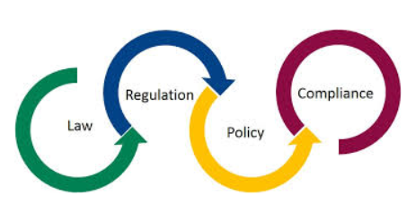
Compliance
the practice of obeying rules or requests made by people in authority
Notes:
Compliance is …………………

Slide 5

Workaround
When there is a mismatch between the expectations of technology and actual working practice, employees may implement a workaround by deviating from a set of procedures.
Informal and temporary practices for handling exceptions to workflow (2005)
Notes:
The second important terms is Workaround.
Lets look at the dictionary meaning, ………………..
And according to literatüre (Kobayeshi et al), workaround is ………………
as highlighted by Button et al., (2003) and Lankshear and Mason (2001) in environments where individuals have insufficient data, unsuitable access or enforced proceduralisation, they may compensate by creating idiosyncratic methods of data collection, data management or working practice, in effect overcoming hindrances or ensuring essential task completion.

Slide 6
Scope
The paper;
Examines current models of resistance
Identify the concept of workaround
Extends previous resistance modes and provide alternative theoretical basis
Implements and analyzes two case studies
The paper;
identifies workarounds as an additional dimension to studies of resistance.
Notes:
The scope of the paper, that we are analyzing now is to examine

Slide 7
Categorization
COMPLIANCE
RESISTANCE
WORKAROUND
Multilevel model: (1991)
Individual
Group
Organization
Type model: (2005)
Passive
Active
Aggressive
Notes:
The terms, compliance, resistance and wokaround are often mixed and used interchangeably in literature. However, mentioned terms have a distinct depth seperating themselves from each other.
In literatüre, a number of authors argue the subject and create categorizations about it.
As examples, according to Joshi (1991), resistance can be grouped in a multilevel model, which’s sub categaries are: individual, group pr organization.
According to Lapointe (2005), resistance can be grouped according its type. Which are: passive, active and aggressive.
The various resistant behaviours highlighted by these models show that resistance can exist in various forms. That is why different aouthors tried to define different categorizations for resistance.

Slide 8
Categorization of Resistance
Category | Explanation/Definition
Compliance | The user interacts with the system in the prescribed manner
Resistance | Opposition, challenge or disruption to processes or initiatives
Negative Resistance | The rationale is to oppose or deceive
Positive Resistance | The rationale is to support or improve
Workaround | The action ensuing from resistance
Hindrance Workaround | The workaround is undertaken to circumvent system procedures or process perceived to be too time consuming, onerous or difficult.
Harmless Workaround | The workaround does not significantly affect workflow or the accuracy of captured data
Essential Workaround | The workaround is essential in order to complete the task at hand
Notes:
Drawing from the literature, an initial taxonomy is presented in table, each category is then reviewed in turn.
Firstly, compliance assumes that the user interacts with the system in the prescribed manner.
Secondly, resistance is the opposition, challaenge or disruption to process or initiatives.
Resistance can be subdivided into two categories: positive and negative.
The rationale of negative resistaance is to oppose or deceive. The examples can be physical sabotage; conciously entering of incorrect data, and omission of auditable steps in procedures.
On the other hand, the rationale of positive resistance is to support or improve. As examples, by deviating from procedure, the worker seeks to support or improve working practices.
Thidly, workaround is the action that comes after the resistance.
Workaround activity can be subdivided into three categories.
Hindrance (önleme, engelleme) workarounds occur when the use of the system is viewed as too time consuming, onerous, or difficult. There is no specific dissatisfaction from the system, rather the worker perceives that the system is difficult, they may not see the point or relevance of the data that they are entering and therefore partially enter data, enter approximate data or fail to fully comply with procedure. Worker typically manifest by behaviours such as deviation from procedure or covert co-operative working and seeks to support or improve working practices.
As further illustration, in Timmons’s (2003) study of patient care plans in UnitedKingdom hospitals, a monthly audit found that according to computer records, one ward had only six patients. Nursing staff had failed to enter and update patient information seeing accurate data entry as a hindrance and as low priority in comparison to their ‘real’ job of nursing patients.
The second category is harmless workaround which occurs when users do not use the system in the prescribed manner but their workarounds do not affect workflow or the accuracy of captured data.
The last category is essential workarounds that are essential in order to complete the task at hand.

Slide 9
Case Studies
Causal description
Interactive model of data analysis
Data collection
Data reduction
Data display
Conclusion drawing & verification
Notes:
In the following section we seek to explore the compliance/resistance/workaround relationships from the perspective of the participants in two highly operationally controlled case studies.
In the context of this research, we aim to examine the phenomenon of user workarounds.
In order to analyse the actuality of workarounds this research draws deductively from existing
literature and then, using an inductive analytical approach, the initial conceptual framework is
further explored and refined at two case study sites, providing a ‘causal description’ of the
manifestations of workarounds and their impact. To achieve this we adopt an interactive
model of data analysis the four components of which (data collection, data reduction, data
display and conclusion drawing/verification) are conducted continually and iteratively rather
than as a linear process.

Slide 10
Case Studies
Highly operationally controlled environment
Clear preset routines, procedures & practices
Limited initiative
Autonomy over work activities
Strictly dependent on prescribed work routines
Notes:
Two case studies that conducted within the study have some common points. These ar, both of them HAVE….

Slide 11
Case Studies
Conducted between years 2003-2006
Participant observation
Watching
Listening
Interviews
Document analysis
Cross-case comparison
Notes:
Both case studies conducted between years two thousand three and six.
Participant observation is included via watching …………………
Cross-case comparison is also conducted as another methodology.

Slide 12

Case Studies
#1: GarmentCo | #2: UK regional Fire Service
Service Industry (clothing) | Public sector
15 interviews -3 managers -2 supervisors -10 operators | 14 interviews -3 senior managers -8 middle managers -3 data analysis personel
20 hours participant observation | 24 group interviews -8 to 15 Fire Officers
Notes:
Case one is conducted in a clothing company, and case two conducted in United Kingdom’s regional Fire Service.
Fifteen interwiews conducted Within case study one and fourteen interviews conducted in case study two. You can see the distribution of participant demography on the board.
Observation made Within case study one is about twenty hours.
On the other hand, Within case study two, twenty four interviews conducted with groups of eight to fifteen fire officers.

Slide 13
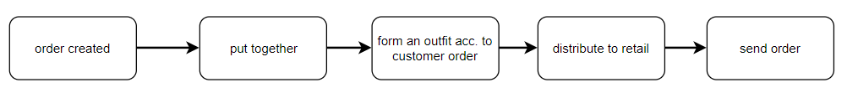
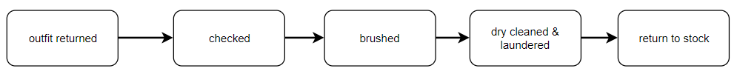
Case #1 - Process
Given Order:
Returned Order:
Notes:
GarmentCo is an online store that sells formal clothing for men including jackets, trousers, waistcoats, shirts, ties and other accessories.
Two operational scenarios are analysed within the case study.
One of them is the scenario of a given order.
When an order is given, the components in the order is put together.
The components are put together in the required sizes and styles to form an outfit according to the specifications of the customer.
The order distributed to retail and then send to customer.
Second scenario is about a returned order.
When an order is returned, the clothes are checked, brushed, dry-cleaned or laundered as appropriate, and then returned to stock.

Slide 14
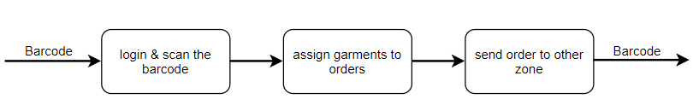
Case #1 - Process
IT Side – Trousers Zone:
At least one operator / zone
Aims to process 30 orders / hour
Data used for
Target setting
Trend analysis
Stock renewals
Resource planning
Notes:
Lets look at the scenario from IT side of the system.
When an order has been created, an order ticket is printed on the shop floor containing a barcode and all the component garment details. The user uses a personal login and scans the order barcode to assign garments to orders. The ticket follows an automatic conveyancing system around the factory which serves to transport the outfit through areas which contain individual items of clothing such as jackets, trousers, shirts, waistcoats, shoes, hats, and accessories. The accompanying ticket shows which style and size to pick from each
area.
Each shop floor zone has at least one operator that select garments, scan the barcode and attach them to the appropriate order.
The outfit continues around the shopfloor until all items are picked and then it is dispatched.
The system aims to process 30 (thirhty) orders per hour.
The collected data from IT system is used for target setting, trend analysis, stock renewals and resource planning purposes.

Slide 15
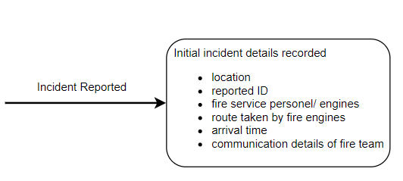
Case #2 - Process
Notes:
The regional Fire Service case study is concerned with the mobilisation of fire engines to incidents and the reporting of said incidents.
Within case study two, two phases of an incident are analyzed. These are the cases «when an incident is reported» and the other one is «after the incident».
As incidents are reported to the Fire Service a centralised control office records initial incident details including incident location, who has reported the incident, Fire Service personnel and fire engines that are dispatched immediately and subsequently, the route or routes taken by fire engines, arrival time and a log of all communications with the deployed Fire Service teams.

Slide 16
Case #2 - Process
At anly level of officer can be assigned to completing the report
Data used for
Allocation planning of human and physical resources
Allocation of funding
Making policy decisions
Notes:
During and after the incident a detailed electronic report is completed on the incident, the report is semi-structured and any level of Officer can be assigned the responsibility of completing the report.
Structured attributes include cause of fire, location within the address, degree and speed of fire spread, number of casualties, other emergence services involved, specific equipment used and arrival and departure times.
Free format responses include incident handling strategies and lessons learnt.
These reports are collated and summarized by a centralized office that then presents the abstracted results to management who plan the allocation of future human and physical resources from this data. In addition the summarized data is reported to central government who allocate funding and make policy decisions based on the data.

Slide 17
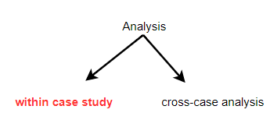
Case Studies - Analysis
Unique patterns
Individual workaround behaviors
Individual instances clustered
Notes:
The case study data was analysed in two stages, within-case analysis and cross-case analysis.
Within-case analysis was performed to allow unique patterns to emerge and the researchers to gain a richer understanding of each case study.
Individual workaround behaviours were analysed identifying the rationale for deviating from the prescribed process or procedure.
Individual instances were then conceptually clustered with different clustering permutations being trialed; the researchers undertook the clustering process independently and then
collaboratively.

Slide 18
Case #1 - Analysis
Batch processing:
“Workers often … compile several similar orders at once”
Sub-tasking:
“We will break down orders [into subcomponents] to find matches which we can pick together”
Predictive operating:
“Workers begin to compile the next order which hasn’t even reached
them yet”
Notes:
In the case study number one, some workaround practices were observerd.
Lets look at them one by one with their examples.
The first one is batch processing. The example about it is: ………

Slide 19
Case #1 - Analysis
Indolence:
“Targets are set too low and workers slack off when they have reached
them”
“there’s all sorts of things we can do to get a skive, or make the
conveyor stop and get overtime to finish that day’s orders”
“Some targets are way too high, completely impossible, we don’t even try”
Stockpilling:
“We often double scan [each others] garments to ensure our [personal] count goes up”
Buddying:
“I’ll do some for you as you have a hangover”

Slide 20
Case #1 - Analysis
Bargaining:
“I’ll give you some cigs if you do some under my code”
Bullying:
“They have to do some under my code or there’ll be trouble”
Sabotage:
“Computer mouse balls have been removed and keyboard keys pulled off”

Slide 21
Case #2 - Analysis
Retrospectivity:
“I have to enter the data after the event from what the lads and I can
remember, sometimes, if it is the next day, we can’t remember details”
Collective data generation:
“We work as a unit, as a team, it doesn’t matter how it’s recorded”
Inaccurate data entry:
“We sometimes request equipment we ‘may’ need and then justify it later by describing the incident as though we needed the kit”
Incorrect data entry:
“Once we get near the fire, we press the arrived button, to make sure we are within time”
“If we are later than target, we ‘forget’ to press the arrived button, then it has to be done over the phone later.”
Notes:
Now lets look at the workaround examples that are observed in Case study number two.
The first one is retrospectivity. The example about it is: ………

Slide 22
Case #2 - Analysis
Indolence:
“Once it’s logged in, it’s logged in for the day, I have never seen
anyone log out and back in under their own password”
Sabotage:
“I’ve brought viruses in from my kid’s machine, it takes 2-3 days for the IT guys to come out and remove viruses from the Station’s PC. This eliminates the need for report generation for that period of time. ”
Non-use/ Inaccurate use of the system:
“Each incident requires individual dynamic risk assessment, and there are times when policy is not followed”
“The form doesn’t let you describe what really happened, it’s just making the fire fit the form, it isn’t an accurate account”
“The report I saw was not for the fire I went to”

Slide 23
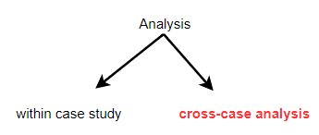
Case Studies - Analysis
Common themes
Unique patterns
Causes & pre-existing conditions
Notes:
The second stage of case study analyses is cross-case analysis.
Cross-case analysis was undertaken using analytical induction to identify both common themes and unique patterns or behaviours.
Abstracting from the individual cases we focussed on the causes, pre-existing conditions or antecedents that generated the resultant behaviours of workaround.

Slide 24
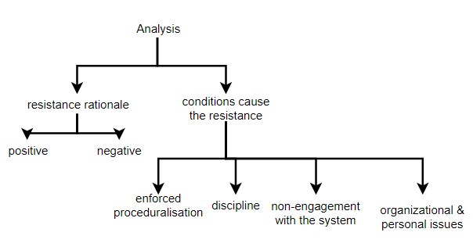
Case Studies - Analysis
Notes:
Our specific interest was in finding the resistance rationale (positive or negative) and the antecedent conditions from which that
resistance rationale emerged. The derivation of the resultant antecedent conditions is
İllustrated in the diagram, that ‘Enforced Proceduralisation’, ‘Discipline’, ‘Non-engagement with the System’ and ‘Organisational and Personnel Issues’,

Slide 25
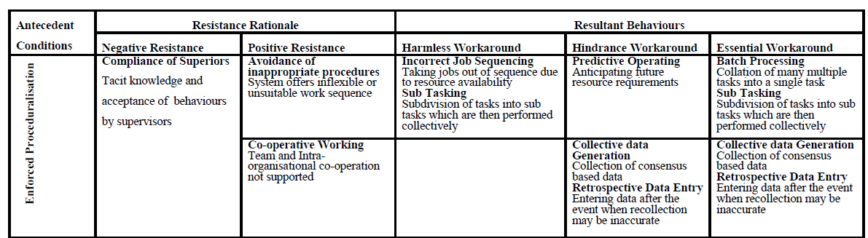
Enforced Proceduralisation
Notes:
The antecedent condition ‘Enforced Proceduralisation’ assumes chronological or consecutive job sequencing and that each task is carried out by only one operator from start to finish. The workarounds occur when the application of the model is placed outside and before its enactment.
For example, many systems do not recognize that operators provide cooperative support that may involve logging onto someone else’s system, even though this may not be a part of their formal work description. Thus, it may be that abstracting from the case studies, ‘Enforced Proceduralisation’ provides the underpinning rationale for negative resistance through compliance of superiors in harmless workaround acts such as incorrect job sequencing and subtasking and essential workaround acts such as retrospective data entry. Furthermore, ‘Enforced Proceduralisation’ provides the underpinning rationale for positive resistance in two forms. Firstly, avoidance of inappropriate procedures which may result in workaround actions including predictive operating and sub-tasking. Secondly, the inhibition of co-operative working restricting groups, teams and organisations ability to generate collaborative data resulting in essential workaround actions of retrospective data entry and collective data generation. For illustration consider the Fire Service case study where lack of support for co-operative working emerged. The incident recording system assumed a single Fire Officer recorded the incident individually whilst in fact several Fire Officers would usually contribute to the generation of an incident report giving different perspectives and effectively generating a multiple authored report.

Slide 26
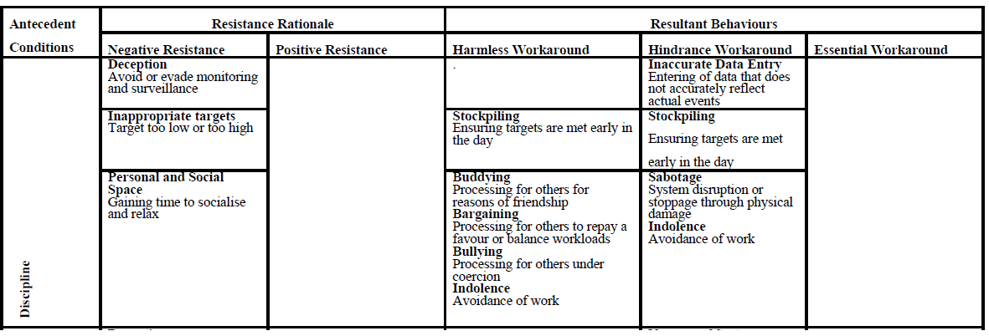
Discipline
Notes:
Our second identified antecedent condition is derived from the dichotomy between technologically managed bureaucratic control and the social structures inherent in the workplace, we named this antecedent condition ‘Discipline’.
In the case studies the ‘Discipline’ imposed by surveillance and target setting led to negative resistance in three forms: deception, target avoidance and acquisition of personal and social space. The resultant behaviours included sabotage, indolence, buddying, bargaining and bullying. In the case studies, deception was commonplace, for example easily achievable targets at Case1 resulted in operators slackening off when targets were achieved and creating diversionary workarounds to give themselves personal or social space, such workarounds, manifest as buddying, bargaining and bullying were either categorised as harmless in that the underlying data required by management was not damaged, or as hindrance workarounds as, for example, the workforce perceived the rigour imposed by the system hindered their ability to interact with their colleagues. However, it may be noted that from a social perspective such activities may not necessarily be regarded as harmless.
Similarly in the Fire Service unachievable targets regarding incident arrival time resulted in system deception For example, consider a group of Fire Officers reporting on a burnt out
stolen car incident, they may record the probable cause of the incident as: ‘spontaneous combustion’ (i.e. it caught fire having rolled over or having hit an obstacle) or ‘arson’. If they
record it as ‘spontaneous combustion’ they have to engage in minimal liaison with the Police however if they report it as ‘arson’ then more extensive collaboration with the Police is
required. It is commonly accepted across all levels of the Fire Service that the actual arson figures are much higher than those recorded and no pressure is brought to bear to ensure more accurate reporting. Yet, the drop in arson rates is also reported to the general public in percentage terms. This example of inaccurate data entry, as an enactment of a hindrance
workaround, spans a range of issues including deception and compliance of superiors .

Slide 27
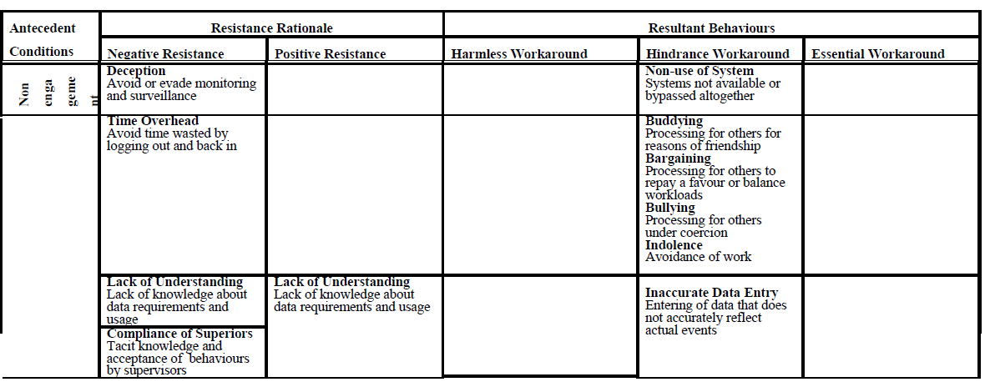
Non-engagement with the system
Notes:
Our third identified antecedent condition is derived from the refusal of users to fully engage with the system or correctly identify themselves to it, we refer to this as ‘Non-engagement
with the System’. Many systems are unable to employ and utilise the flexibility common to human interactions and indeed on occasion they actively inhibit such skills and only work
well when circumvented by users.
In the case studies ‘Non-engagement with the System’ provided the rationale for negative resistance through deception, avoidance of time overhead and compliance of superiors and for both positive and negative resistance in the form of lack of understanding. Illustrative behaviours from the case studies include at Case1 the use of other operatives’ user IDs due to indolence, and in the Fire Service, inaccurate data entry to bypass the time overhead involved in thorough and accurate reporting. In addition there was a lack of understanding about the usage of data generated by the system: “Don’t know what they use it for, don’t care”, and the avoidance of the time overheads: “it’s not worth the time to log out and back in again, it takes ages”. Compliance of Superiors in these workaround strategies was also apparent particularly at supervisory level, their attitude being that data capture was a secondary, or even trivial consideration, did not matter and hindered workflow: “we are not interested as long as the job gets done”

Slide 28
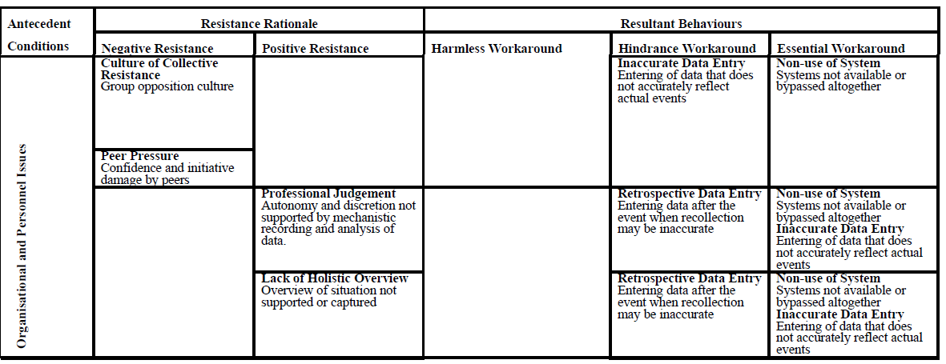
Organizational & Personal Issues
Notes:
Our fourth antecedent condition is derived from the importance of social relations in the workplace and is referred to as ‘Organisational and Personnel Issues’. Studies have shown
that the emergence of new technology may reduce traditional time-wasting techniques, but alternative ways of reappropriating time are invented by workers who wish for a break
In the case studies ’Organisational and Personnel Issues’ provided the underlying rationale for negative resistance in the form of collective resistance and peer pressure and for positive resistance in the form of the exercising of professional judgement and overcoming a lack of opportunity to record or provide an holistic overview. Illustrations from the case studies include a number of examples in the Fire Service where workplace culture was significant and influenced system use: “You get the micky taken out of you if you’re too keen to fill in the forms .. there’s no point .. you only get laughed at”. Collective resistance against the system also occurred: “There is active discouragement of IT use amongst the lads” and “They [senior officers] don’t want us to use it, they think we’ll mess it up”. There was also a lack of holistic overview between different fire stations: “Debrief should be about the whole incident, not just one crew”.

Slide 29
Discussion
The division of resistance into categories such as positive/negative fails to address a number of important points.
Many authors have studied resistance but have failed to consider the resultant activity, or workaround, as a separate, distinct and subsequent phenomena.
Drawing from the literature and using a deductive analytical approach, we propose an initial conceptual framework that differentiates between compliance and various types of user resistance and workaround.

Slide 30
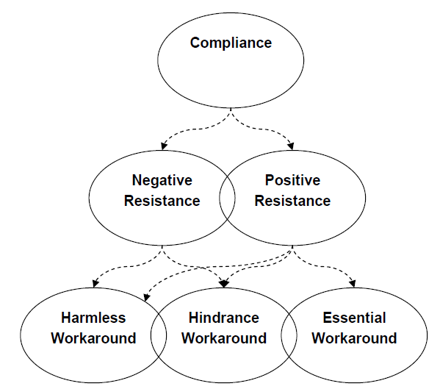
Discussion
Notes:
This conceptual framework can be seen on the screen.
Compliance can cause both negative and positive resistance.
Potential behaviours resulting from positive or negative resistance are defined as workaround activity. Specifically, three strands of workaround activity are proposed – harmless workarounds, hindrance workarounds and essential workarounds.
While harmless and hindrance workaround can be originated from both negative and positive resistance.
Only essential workarounds’ origin can be a hundred percent truly guessed as positive resistance.

Slide 31
Discussion
Further research is required to examine common factors, but a brief overview would suggest that the emergency nature of activities, the critical and fast changing decisions that are made, and the dynamic interactions between agents appear difficult for an information system to support.
Revisiting previous models of resistance, single antecedent conditions are attributed to specific resultant resistant behaviors.
Our research reveals that these conditions can lead to resistance, be it positive or negative, which may result in different kinds of workaround behaviors.

Slide 32
Conclusion
In conclusion this study has re-examined the notion of resistance as reported in information systems literature and has utilized case study research to examine this further.
As a result of the consolidation of both accepted literature and our own case study findings, we propose the new compliance/resistance/workaround model.
This model identifies workarounds as a related but separate and distinct phenomenon from that of resistance.

Slide 33
Conclusion
The limited studies on information systems workaround have focussed on the Health Service where, due to Professional autonomy and the emergency nature of activities, workaround is perhaps unsurprising. Our studies have been at operator level in highly operationally controlled environments, where it might be expected that deviation from set procedure would be minimised, yet workaround has been shown to still exist.
By developing a composite model of user resistance/workaround we aim to further contribute to this understudied field and to suggest that it may be useful to all concerned with information systems development and implementation look deeper into the reasons why systems are not used as expected.

Slide 34
References
[1] E. Ferneley, P. Sobreperez, Resist, comply or workaround? An examinaion of different facets of user engagement with information systems., University of Salford Manchester, 2006

Slide 35
Questions & Comments

